Slide 1
Graph based Clustering
Jieping Ye
Department of Computer Science and Engineering
Arizona State University
http://www.public.asu.edu/~jye02
Office: BY 568

Slide 2
Outline of lecture
What is graph based clustering?
Overview of the available graph based clustering algorithms
  Minimum cut
  Normalized cuts
  K-way normalized cuts
Comparison of different algorithms

Slide 3









Weighted graph
A weighted graph includes a set of vertices, edges, and the weights corresponding to the edges.
  G = (V,W,E)

Slide 4
Graph based clustering
Associate each data item with a vertex in a weighted graph, where the weights on the edges between elements are large if the elements are similar and small if they are not.
Cut the graph into connected components with relatively large interior weights by cutting edges with relatively low weights.
Clustering becomes a graph cut problem.

Slide 5
Example

Slide 6
Two different clustering methods
Method #1
  Partition into two clusters
  Use procedure recursively
Method #2
  Directly compute k-way partitioning
  Experimentally has been seen to be better

Slide 7
Illustration
Method #1
Method #2

Slide 8
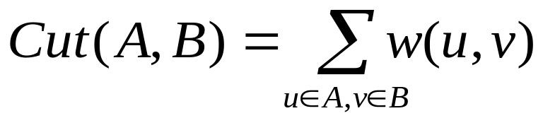
Method #1: Graph cut
A graph G=(V,W,E) can be partitioned into two disjoint sets A, B, with A ∩ B = Ø.
The degree of dissimilarity between these two sets can be computed as total weight of the edges that connect these two sets. In graph theoretic language, it is called the cut:

Slide 9
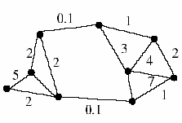
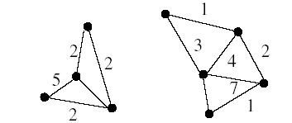
Illustration

Slide 10
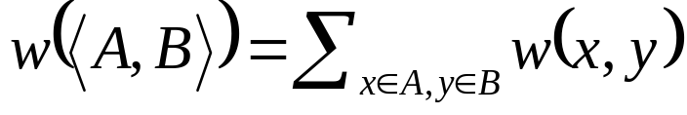
Minimum Cut
A cut <A,B> of a graph G is the set of edges S that connects vertices of A to vertices of B.
Minimum cut is the cut of minimum weight, where weight of cut <A,B> is given as
Wu and Leahy, PAMI’93

Slide 11
Drawbacks of Minimum Cut
Weight of cut is directly proportional to the number of edges in the cut.
Cuts with
lesser weight
than the
ideal cut
Ideal Cut

Slide 12
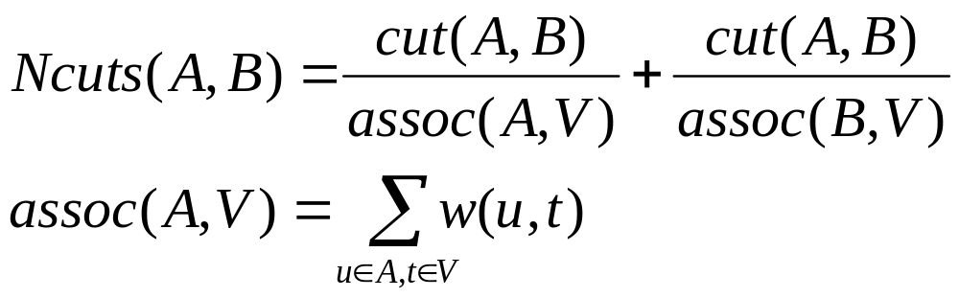
Normalized Cuts
The normalized graph cuts algorithm (Shi &Malik, PAMI’ 00) balances the sizes of the two clusters.
Computes the cut cost as a fraction of the total edge connections to all the nodes in the graph. We call this the normalized cuts (Ncuts):

Slide 13
Normalized Cuts (Cont’d)
A
B
3
4
1
5
2
Cut(A,B) = w(3,4) + w(2,4) + w(2,5)
Assoc(A,V) = w(1,3) + w(1,2) + w(2,3) + w(3,4) + w(2,4) + w(2,5)
Assoc(B,V) = w(4,5) + w(3,4) + w(2,4) + w(2,5)

Slide 14
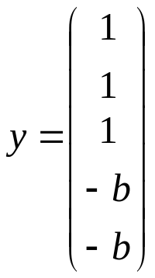
W,D, and y
0 | 0.3 | 0.5 | 0.4 | 0.7
0.3 | 0 | 0.4 | 0.6 | 0.5
0.5 | 0.4 | 0 | 0.8 | 0.6
0.4 | 0.6 | 0.8 | 0 | 0.7
0.7 | 0.5 | 0.6 | 0.7 | 0
1.9
1.8
2.3
2.5
2.5
1.9 | 0 | 0 | 0 | 0
0 | 1.8 | 0 | 0 | 0
0 | 0 | 2.3 | 0 | 0
0 | 0 | 0 | 2.5 | 0
0 | 0 | 0 | 0 | 2.5
W: similarity (affinity) matrix
D
V1: A
V2: A
V3: A
V4: B
V5: B

Slide 15
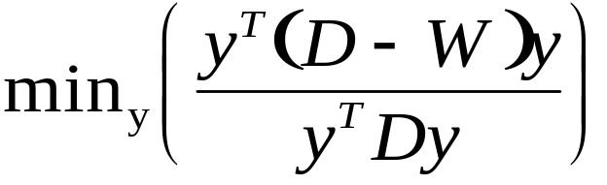
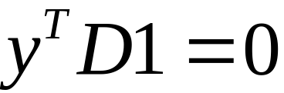
Simplification of the criterion
Write a vector y whose elements are 1 if item is in A, -b if it’s in B
Write the matrix of the graph as W, and the matrix which has the row sums of W on its diagonal as D, 1 is the vector with all ones.
Criterion becomes
Constraint
NP-complete

Slide 16
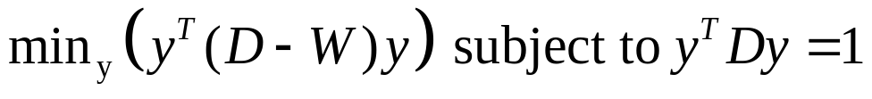

Generalized eigenvalue problem
Instead, solve the generalized eigenvalue problem
which gives
Choose the eigenvector corresponding to the second smallest eigenvalue.
Partition the graph -- All components of y above a certain threshold go to A, all below go to B.

Slide 17
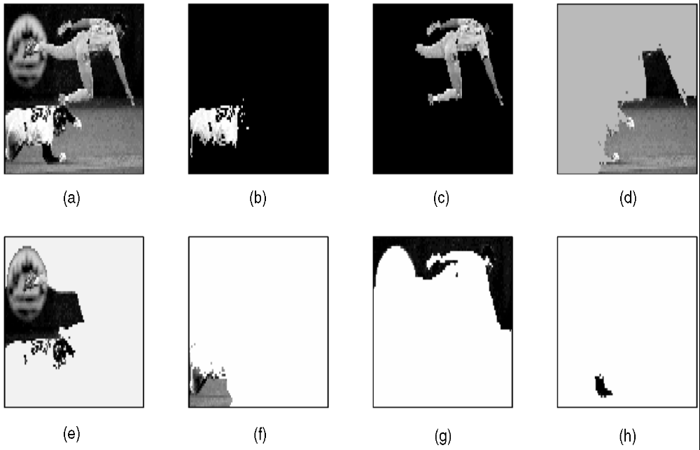
Results on image segmentation

Slide 18



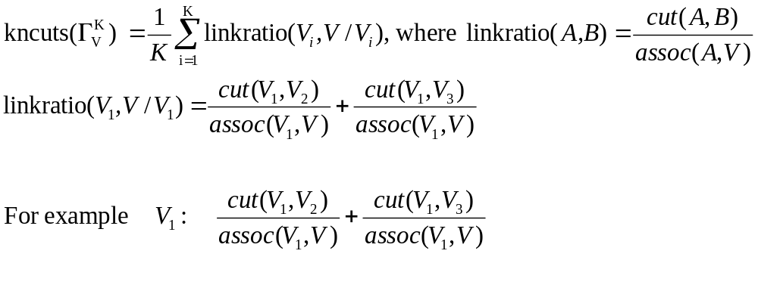
Method #2: K-way Normalized Cuts

Slide 19
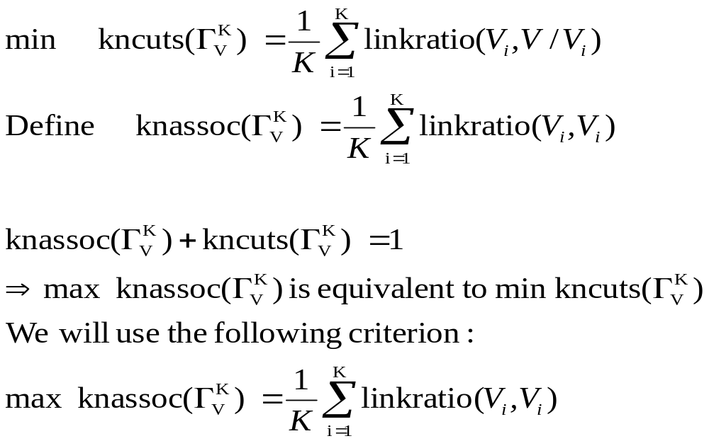
Equivalences between two criterions

Slide 20
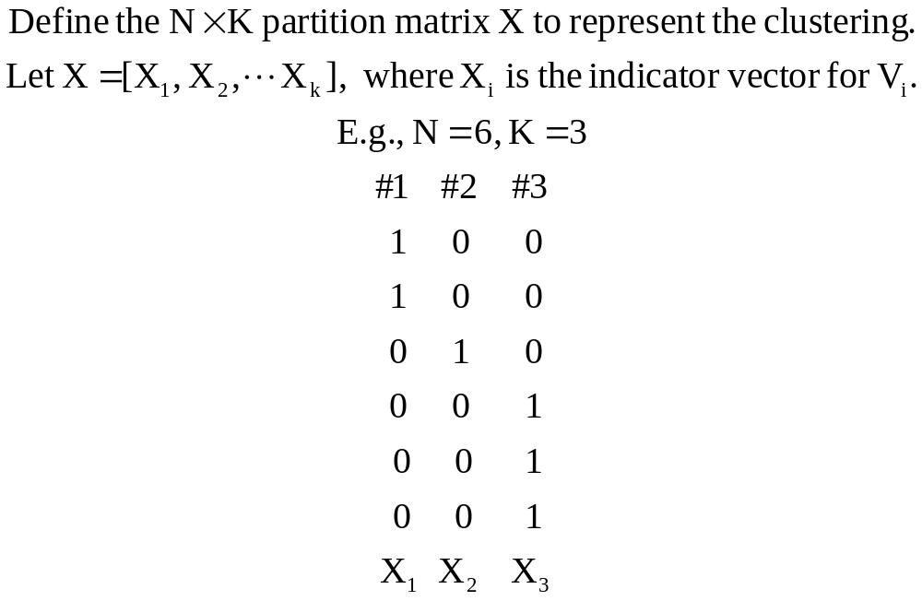
Partition matrix X

Slide 21
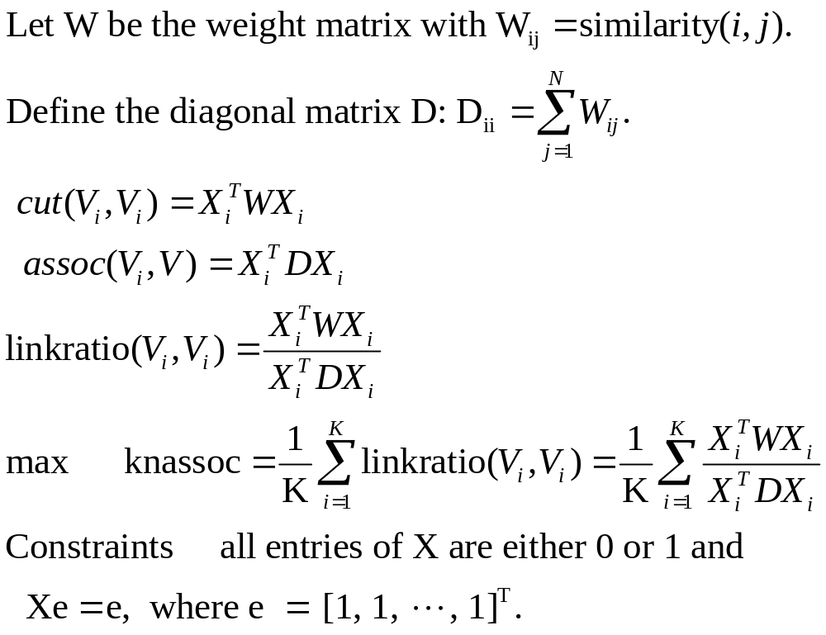
Criterion based on the partition matrix X

Slide 22
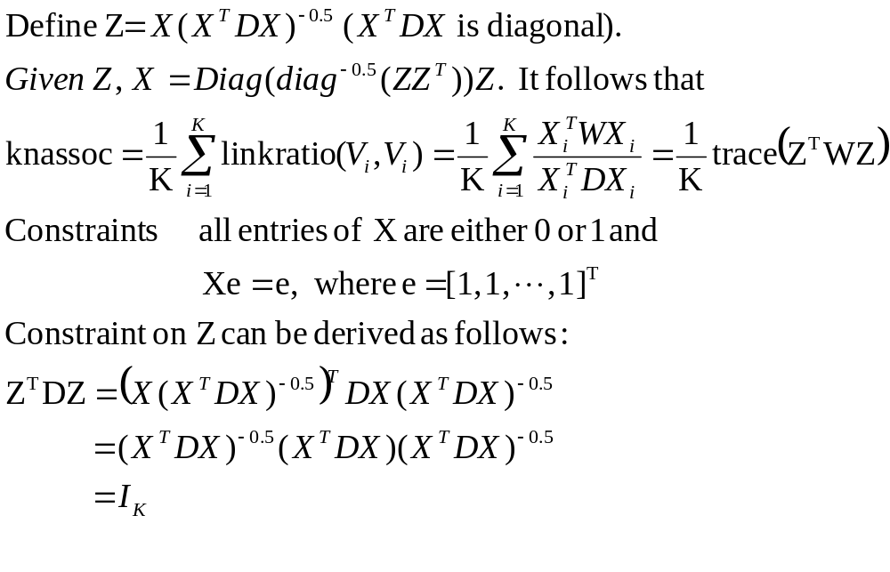
Matrix transformation: X→Z

Slide 23
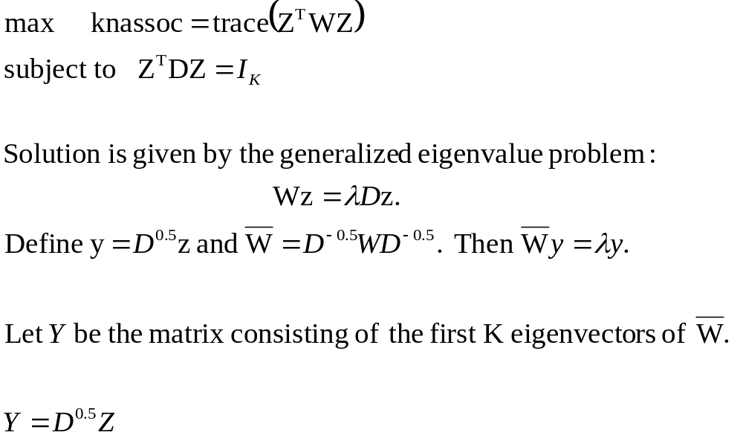
New criterion based on Z

Slide 24
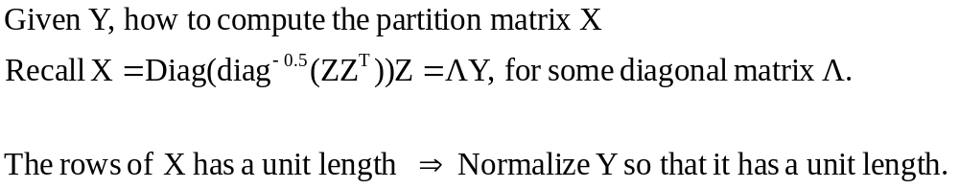
Computation of the clustering
Apply K-Means clustering to the data in Y (after row normalization) to obtain the clustering.
  This approach is adopted by Ng, Jordan, and Weiss , NIPS’02.
Yu and Shi, ICCV’03 computes the clustering by applying iterative optimization.

Slide 25
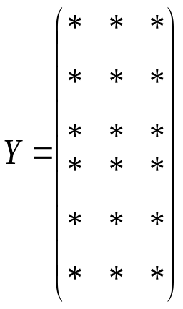

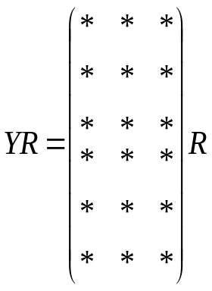
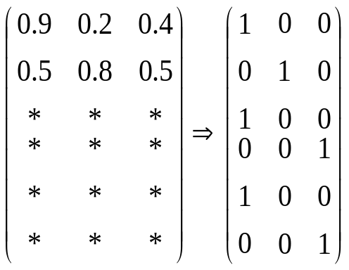
Example
Clustering on the rows
Ng, Jordan, and weiss
Orthogonal matrix R
Yu and Shi

Slide 26

The main algorithm
Compute the similarity matrix W and D.
Form
Form the matrix Y consisting of the first K eigenvectors of
Normalize Y so that all the rows have unit lengths.
Run K-Means on the rows to get the K clusters. (Ng, Jordan, and Weiss , NIPS’02) or
Apply an iterative optimization to get the partition matrix. (Yu and Shi, ICCV’03)

Slide 27
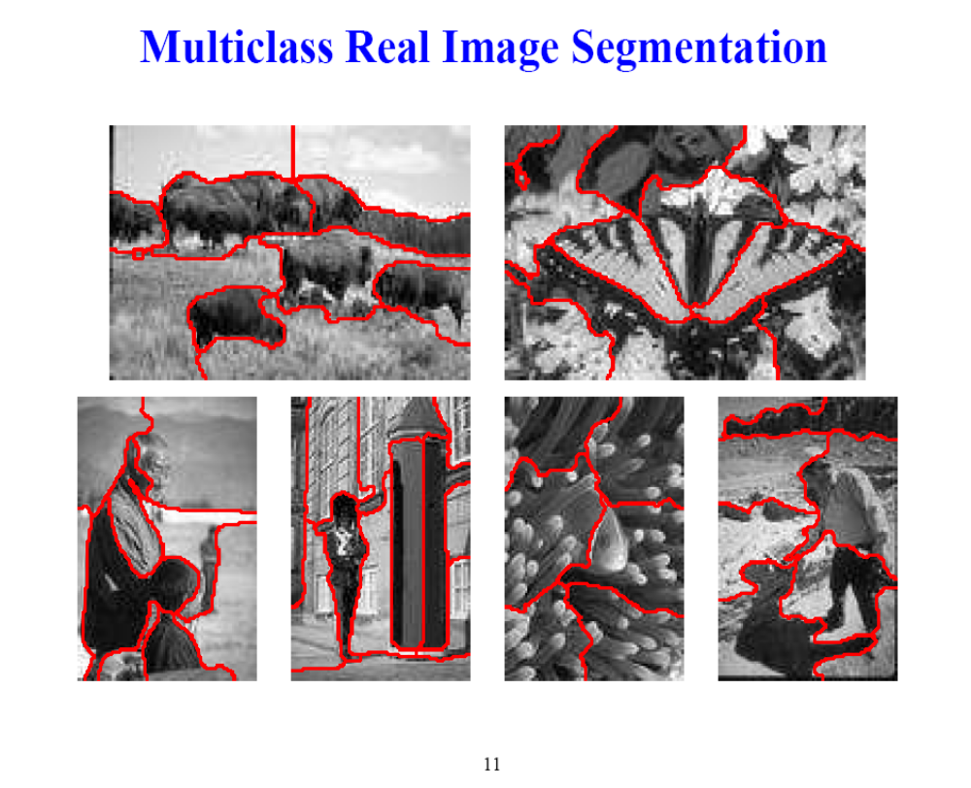
Source: Yu and Shi, ICCV’03

Slide 28
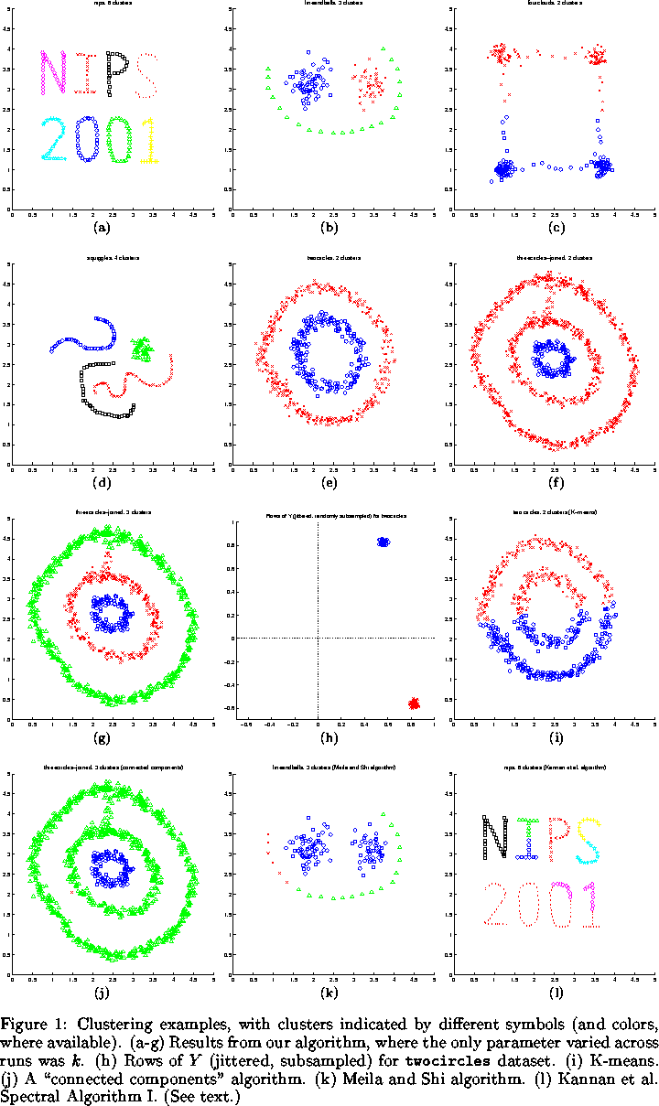
Source: Ng, Jordan, and Weiss, NIPS’02

Slide 29
Summary of Graph based Clustering
Algorithms that cluster points using eigenvectors of matrices derived from the data
Obtain data representation in the low-dimensional space that can be easily clustered
  Find non-convex clusters
Variety of methods that use the eigenvectors differently

Slide 30
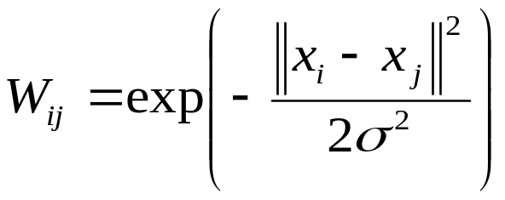
Some issues
Choice of k, the number of clusters
Choice of similarity measures

Slide 31

Comparison of Methods
Authors | Matrix used | Procedure/Eigenvectors used
Wu/Leahy | W | 1st eigenvector of W Recursive procedure
Shi/Malik | W, D | 2nd smallest generalized eigenvector Also recursive
Yu/Shi | W, D User inputs K | Finds k eigenvectors of , forms Y. Normalizes rows of Y. Obtain partition X.
Ng, Jordan, Weiss | W, D User inputs K | Finds k eigenvectors of , forms Y. Normalizes Y, clusters rows

Slide 32
Advantages/Disadvantages
Wu/Leahy
  Good segmentation results
  Favor cutting small sets of isolated nodes
Shi/Malik
  2nd generalized eigenvector minimizes affinity between groups by affinity within each group;
  Constraints

Slide 33
Advantages/Disadvantages
Yu and Shi
  depends on choice of k
  Effective
  No clustering algorithm is applied
Ng, Jordan, and Weiss
  Again depends on choice of k
  Claim: effectively handles clusters whose overlap or connectedness varies across clusters

Slide 34
References
Normalized cuts and image segmentation– Shi and Malik
Multiclass Spectral Clustering– Yu and Shi
On spectral clustering: Analysis and an algorithm – Ng, Jordan, and Weiss
Graph based algorithms for segmentation– Candemir
Spectral Clustering – Nugent and Stanberry

Slide 35
Next class
Topics
  Regression
Readings
  Linear & Ridge Regression and Kernels
  Regression shrinkage and selection via the lasso
  Prediction With Gaussian Processes: From Linear Regression To Linear Prediction And Beyond

